Slide 1

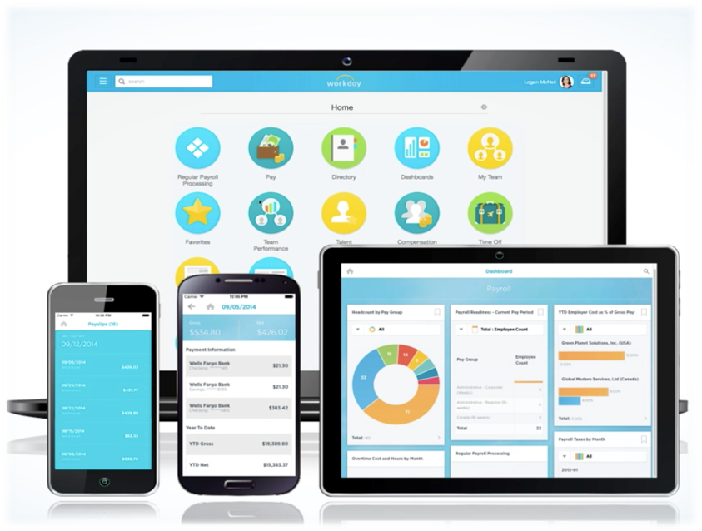
Workday at CMSD
Employee Self Service
for Operations & Non-Exempt Employees
October 2016

Slide 2



Welcome to Workday at CMSD!
Cleveland Metropolitan School District
Learning happens here
Increasing efficiency and effectiveness so we can maximize our focus on our students
Notes:
Welcome to Workday Training!
CMSD is a place where learning happens everyday…by our students in our school classrooms. And by our employees, finding better ways to do things.
Today we are learning to use elements of a new tool.
Why? To help us streamline processes and maintain more accurate data.
So that we can increase our focus on the students!

Slide 3

What is Workday?
…an HR, Payroll and Finance tool
that helps make people & processes
more efficient and effective
Notes:
An HR, Payroll and Finance tool to help make processes more efficient and effective.
Some Systems are Going away. Others have integrations with Workday.
Click on the Workday picture to play video.
How will Workday help? No MORE PAPER!!!

Slide 4














































The WHO of Workday
Who will be using the Workday system?
All of CMSD regular employees will use Workday, including substitutes.
Who helped build CMSD’s Workday system?
Thank you for your hard work!
Notes:
The WHO of WORKDAY
Who will use it?
All employees will use the system, including substitutes.
Who built it?
Not built in a vacuum—these people and many more helped configure it for CMSD needs. And we say Thank you!

Slide 5
WIIFM—the Workday benefits
Ability to Focus on Teaching and Learning
Current, Efficient & Effective Processes
Eliminates redundant processes and minimizes manual work
Breaking Down Silos to Improve Customer Experience
Integrated Systems: HR, Payroll, Finance & Procurement
One Source of Data
Fully Supported
Shift from technology support to academic enablement
User Friendly
Cloud solution
Aligns with The Cleveland Plan
Flexible, user- friendly reports
Promotes Collaboration
Improves collaboration
Improves Employee Self Service capabilities
Systems stay current
Enables Central Office to focus on key support and governance roles
Data transparency throughout the district
Timely and accurate information aids in school budgeting
Same data visible to all users
Notes:
SAY:
No matter where you are in the organization you will experience benefits of Workday.
We will all experience the benefit of having immediate access to data that is important to us. This data is private and secure in our own storage space. Additionally, the system is not driven by SSN, but EEID.
Talk about security here:
You may be wondering about who has access to Info--What info is available to people? What can my managers see about me?
What about other ees? What can I see about others?
Info about your role and work location is available for others in the org. Your personal info is not.
DO NOT SHARE YOUR PW WITH OTHERS—IF YOU DO, THAT PERSON HAS ACCESS TO ALL YOUR PERSONAL INFORMATION!

Slide 6


The Lesson Plan: Today’s Learning Objectives
As a result of this training you will be able to:
Navigate within Workday
View your payslips and tax documentation
Enter and submit your time worked
View Time Off balances and use Workday to request time off, if appropriate for your role
Here’s how we’ll do it:
Demo
Time Tracking practice activities

Slide 7
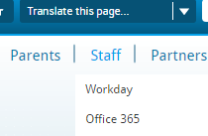
CMSD Workday Webpage
The CMSD Workday Webpage is a resource for you now and later!
From the CMSD web page,
select Staff > Workday
From here, you can:
Find videos and helpful job aids
Provide feedback
Log into the system
Notes:
It’s time to access the internet. Chrome is best browser to support Workday, but you can use any.
Introduce the Workday Website as a resource.
Go to the site and show:
Getting Started for Employees and Managers—a place to watch training videos and get job aids
Contact us tab—a way to provide suggestions and feedback to the project team
Training Tab>Log into Training System. The way to get into the system.

Slide 8
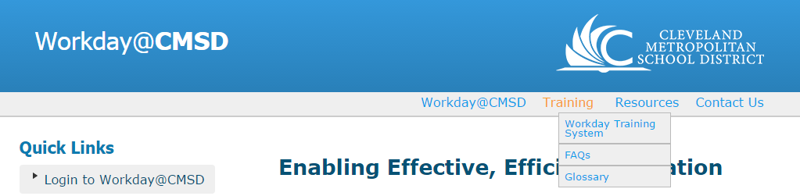
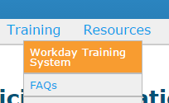
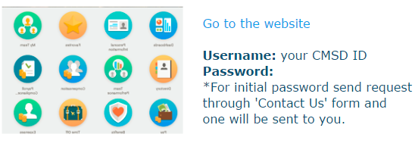

Let’s Log In!
Go to CMSD web page. Select Staff > Workday
  This takes you to the Workday@CMSD web page
Select Training tab at the top > Select Workday Training System
Click “Go to the Website”
Username is: your CMSD ID
Password is: Cleveland123!
z
8
Notes:
Getting to the Workday Training System from the CMSD Website. Staff > Workday > Training > Workday Training System
NOTE: THIS IS A TRAINING SYSTEM! (We are not training in the production environment, so no worries about messing anything up!) It is a place to play. This also means not all of the information that you see may be correct…we have used some of this info for testing.
To log in: Your CMSD USER NAME
Password: Cleveland123! (unless you have already logged into the training system and have saved you PW to something else.)
You will be prompted to reset your PW. Please write this down. You will need it for this training!
When we go live, you will use your CMSD Network PW and you not be prompted to change it automatically.

Slide 9
Navigating Workday
Learning Objectives:
At the end of the module you will be able to…
Navigate the home page
View key information on your Worker Profile
Use the Inbox
Notes:
(7 min) Quickly demo items on the Home page: [See Instructions for Activity 1a]
SAY: “Welcome to the Home page where you can access all your personal information and much more. Let’s explore!”
SAY and SHOW these items:
Home button/Workday button —both bring you back home
Search —it is predictive, meaning it comes up with options that match what you type in
Actions/Related Actions icon —this button allows you to perform additional actions on an item
Worklets—these are apps with actions you can take or reports you can view.
View Inbox Worklet —Inbox has actions you must take, archives of past actions you have taken, and Notifications, including the status of business processes started by you.
We will look at other worklets in a moment.
Worker Profile —This area contains information on you and your job. Mention Action and Team.
View the Contact tab > Support Roles
Support Roles—these are the people who support you. Now if you need to contact your Absence partner or Compensation partner, you know who they are!
6. Inbox—
View the Inbox –this is where actions you must take come to you. You will also get a notice in your CMSD email inbox about these actions, linking you to Workday.
View the Archives: This contains a record of completed actions. You can see the status of events you have initiated
View Notifications: these are alerts from specific business processes that are configured to notify you. (These are viewed from your profile dropdown.)
For more information on Navigation, watch the Getting Started video on the Workday Website. There are also Job Aids for quick reference.

Slide 10
Overview of ESS Worklets
Learning Objectives:
At the end of this module you will be able to…
Us e the Personal Information worklet to update contact and emergency contact info.
Use the Benefits Worklet to view and change your benefits elections when eligible.
Notes:
[See Instructions for Activity 1b]
SHOW: The Personal Information Worklet (2m)
SAY:
“This is where you can update your own personal contact information as well as your Emergency Contact info.
SHOW: (but not a full demo)
Change > Contact Information
Change > Emergency contacts
SHOW: The Benefits Worklet (5m)
SAY:
“With information under the View column, Workday puts your benefits information at your fingertips.
“In cases of a qualifying life event (ie: marriage, adoption) you can change your benefits elections and upload required supporting documentation! This is done under the Change column.
“Best of all, Workday enables employee deduction scenarios for both 10 month and 12 month employees, which means NO MORE DOUBLE DEDUCTION!!!
“More info will come next year during Open Enrollment.”

Slide 11

Just for Fun…
Because Workday calculates benefit deductions for both 10 & 12 month calendars, employees will enjoy no more ________ _____________!
Your Emergency Contact information has changed. What is the correct action(s):
  Contact HR with the updated information so they can make the change
  Go into Workday and make the change yourself.
Notes:
POP QUIZ!
No more Double Deductions in the summer months!!!
2. B: Go into Workday and make the change yourself.
Workday is an Employee Self Service tool. You can complete many actions on your own, ensuring that information is correct.

Slide 12
Pay Worklet & Payroll Management
Learning Objectives:
At the end of this module you will be able to…
Use the Pay Worklet to locate your payslips, supplemental pay history & tax documents
Use the Pay Worklet to change your direct deposit and paycard information
Notes:
PAY WORKLET [See Instructions for Activity 2]
Under Pay VIEW:
QUICKLY SAY/SHOW:
View Payslips
This is where your payslips will appear.
Handout: new payslip
Review payslip with participants.
Point out itemized supplemental pays, employer paid benefits, and employee benefit deductions.
Supplemental pay items appear as separate line items.
SAY: We will no longer mail pay slips. Your old pay slips will not be in Workday, but you can view them from ESWeb.
Bonus & One Time Payment history
This is where supplemental pays and differentials appear.
My Tax documents (W4s)
This is where you locate your W4s
These will be mailed in 2017. After that you will need to access them from Workday.
Under Pay ACTIONS:
SAY:
“Employee Self Service means that you can make updates to your tax withholdings, add or change direct deposit information, and a host of other things.”
“You can change your tax withholding elections from Actions > Withholding Elections.
You can change your direct deposit or paycard information, and add additional accounts from Actions > Payment Elections. You can have up to 10 accounts.”
Your current direct deposit accounts will be carried over to Workday. You do not need to do anything unless you want to add or change an account.
“Watch the Getting Started videos for more detailed information on how to make these changes.”

Slide 13
Just for Fun…
Will pay slips be mailed to your home address if you make a special request?
What will you need to do to ensure your current direct deposit or paycard accounts are in Workday?
How many direct deposit accounts can you have?
Notes:
No—CMSD will no longer mail your payslips. You will need to go into Workday to view them.
Nothing. Your current accounts will be carried over into Workday from the current system.
Bonus! You can have up to 10 direct deposit accounts.

Slide 14

Payroll Process Overview
Every 2 weeks
Every 2 weeks
Every 2 weeks
Day One
Daily
Confirm personal info & payroll elections
Submit time
Approve time
Get paid
Enter time worked
Submit time
$
YOU
YOU
YOU
MGR & TK
YOU
Anytime, 24/7, view real-time information & make updates…
              Your payslips
              Your payroll elections
              Your work time
              Your leave balances
Notes:
Let’s take a look at the Payroll process so you know how Payroll knows what to pay you for. Workday puts the accuracy of your paycheck in your hands—here’s how…

Slide 15
Time Tracking
Learning Objectives:
At the end of this module you will be able to…
Understand CMSD’s policy for tracking your time worked
Recognize the time tracking style for your job profile
Enter your time worked, according to your job profile
Add supplemental pay when applicable
Correct entered time if you have made a mistake
Notes:
Time Tracking (45min)

Slide 16
CMSD Time Tracking Process
Workday will allow employees to be paid accurately and on a timely basis.
All employees will report their time worked.
Time entries must be accurate. It is the responsibility of the employee to ensure accuracy. Employees must submit the actual time worked.
Time entries should be made on a daily basis.
Time entries will be submitted for Manager approval and paid every two weeks.
Time entries will be validated by Timekeepers or Managers.

Slide 17
Non-Exempt Time Tracking Process
Check in/Check Out for Regular Time Worked (Time Clock/Web Clock)
In/out
Worked through lunch
Employee
Add Supplemental pay (web calendar)
Select time type
Enter details
Submit Time Worked
Certification of Effort
DAILY
BIWEEKLY- Friday
Approve
Send back
Deny
Timekeeper
Monday
Approve
Send back
Deny
Manager
Tuesday
Moves to
payroll
Payroll
Notes:
Say:
This is the time entry work flow for Non-Exempt employees. Let’s talk through the workflow first and then we will go into the system and practice entering time. (review by swimlane)
Non-Exempt employees use Workday’s Web Clock/Time Clock to check in for regular time worked. This time stamps your start time. You will also use the Time Clock or Web Clock to check out at the end of the day.
Note: If you work at a location where there is a Time Clock Unit that reads your badge to clock in and out, you must use this to clock in and out. Time Clock units are installed at high traffic areas at the following locations:
Transportation 79th Street Bus Depot (2 clocks)
Transportation 49th Street Bus Depot (2 clocks)
Transportation Office at Ridge Road
Transportation Body at Ridge Road
Trades Office at Ridge Road
Central Kitchen
CMSD will continue to add time clock units in locations across the district, with the goal of having time clocks in all locations within two years of Go Live for use by all non-exempt employees.
If you do not currently work where there is a time clock unit installed, please use existing computers to log into Workday and check in using the Web Time Clock.
If you have Supplemental Pay (ie: working out of classification, etc), you will enter that time daily from the Workday Web Calendar. We will practice this in a moment.
You will submit your time worked and confirm certification of effort biweekly (every other Friday).
Time worked is then sent to the Timekeeper for validation which they complete on Monday.
Time is sent for Manager approval on Tuesday. Upon approval the time entry is forwarded to Payroll for payment.

Slide 18
Non-Exempt Time Tracking Demo
Web Clock to Enter Regular Time worked
Time Clock Units for Regular Time worked
Supplemental Time:
  Cleaners: Mat Cleaning
  Laborers: In Charge
  Trades: In Charge
  Custodians & Assistant Custodians: Permit Work
  Food Service: Working out of classification
  Transportation: Called back After Regular Shift
  Security: Permit Work
  Inclement Weather—ALL
  Floating Holiday--ALL
Submit Time
Modify regular time—timekeeper assistance
Modify supplemental time
Notes:
[See Activity Instructions #3—Ops and NonExempt Non-Union]
Web Clock to Enter Regular Time worked
Time Clock Units for Regular Time worked
Enter Supplemental Time:
Cleaners: Mat Cleaning
Laborers: In Charge
Trades: In Charge
Custodians & Assistant Custodians: Permit Work
Food Service: Working out of classification
Transportation: Called back After Regular Shift
Safety & Security: Permit Work
Inclement Weather--ALL
In cases of Inclement Weather when schools are closed but a unionized employee comes into work, the employee is paid for their regularly scheduled hours plus whatever they actually worked. The employee must enter the time they actually worked into Workday as Supplemental Pay. (The system is already configured to pay them the regular time without Time Clock check in.)
For Inclement Weather Supplemental Pay, from the Time worklet > Enter Time This Week (Web Calendar):
1. Click on Time Type.
2. Select the appropriate Supplemental Pay option > Inclement Weather
3. Manually enter time In and Out.
4. Enter Details as required in the Comments field.
Floating Holidays (ie: Memorial Day, Fourth of July)—ALL
Operations employees eligible to be paid for a floating holiday must add this to their Time Entry.
From Time Worklet > This Week (Web Calendar) > Time Entry > Select Floating Holiday from drop down list.
Submit Time
Modify regular time—timekeeper assistance
Modify supplemental time

Slide 19
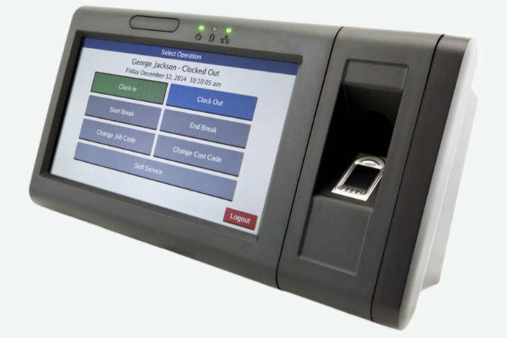
Clocking In / Clocking Out

Slide 20
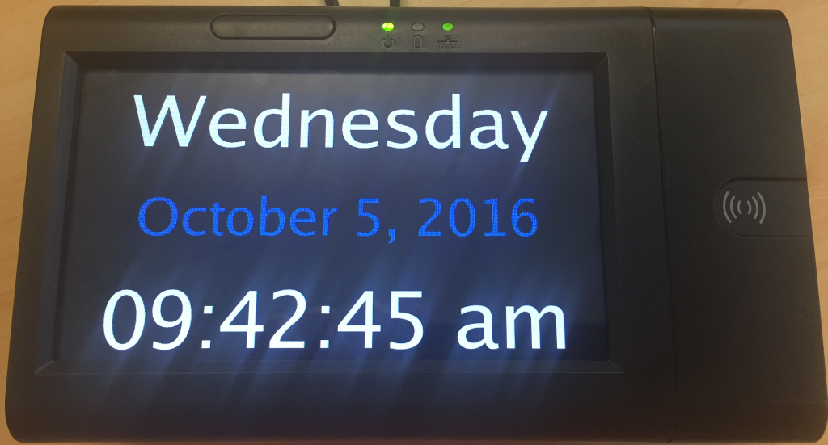
Time Clock Waiting
Time clock waiting for a transaction.

Slide 21
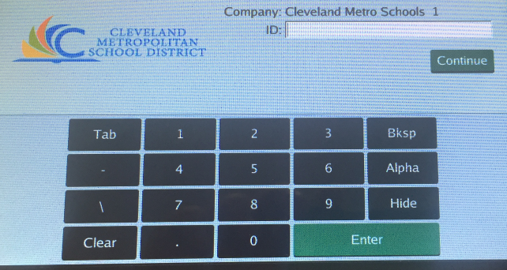
Enter ID Number
The clock is waiting to receive an ID.
Notes:
Touch the screen or put your proxy card up to it.

Slide 22
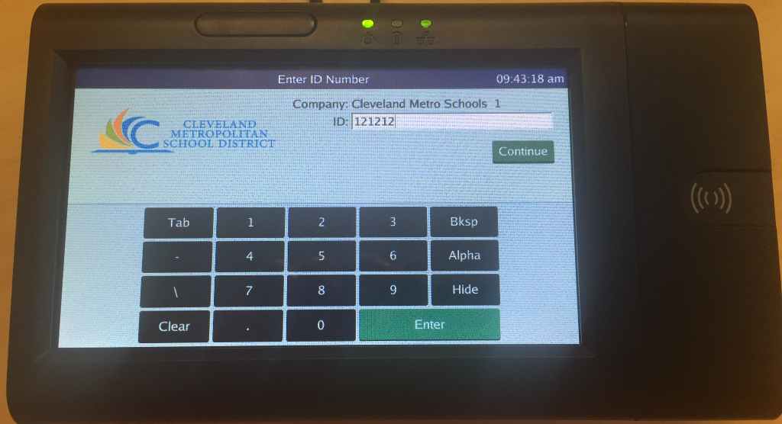
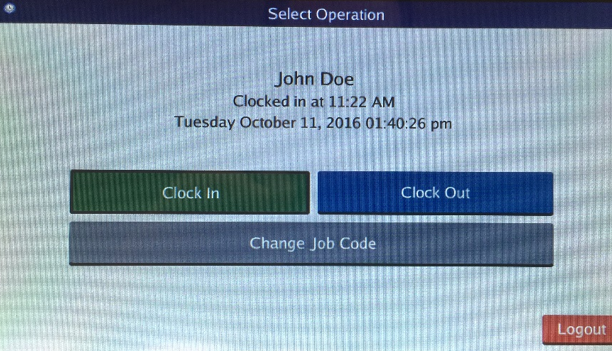
Clock-In
Key in your Employee ID number using the
on-screen pad
or
use your proxy badge.
Notes:
Not everyone will have multiple job codes. If you do not have multiple jobs, you will not see the Change Job Code as an option. (this is mostly for Trades)

Slide 23



Select Operation
Select ‘Clock In’ to check in.
Select ‘Clock Out’ to check out.

Slide 24
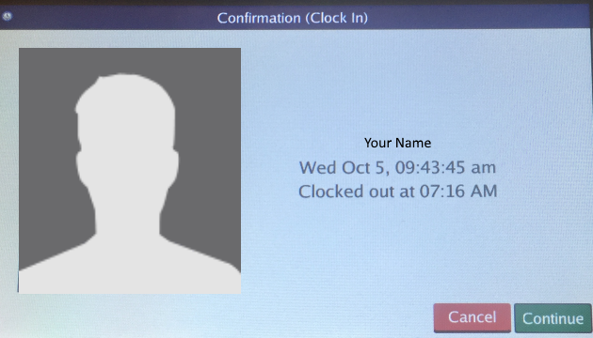

Confirmation
The Clock will show a confirmation screen after you clock-in/clock-out.
Press to continue.

Slide 25
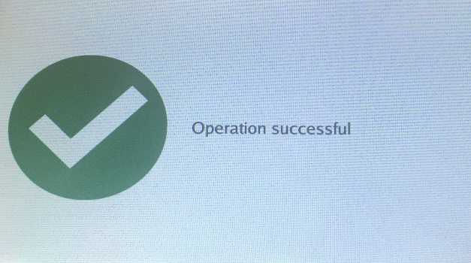
Successful Transaction
The Clock will show a successful screen with the transaction is complete.

Slide 26
Change Job Code

Slide 27
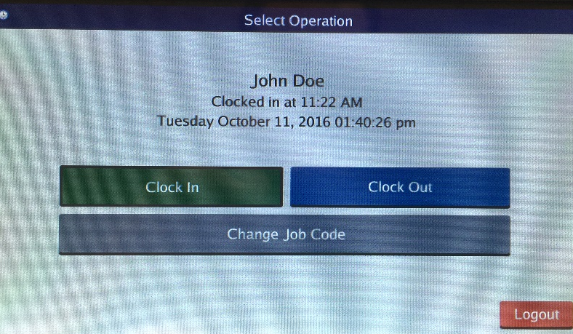
Clock-in
Key in your Employee ID number using the
on-screen pad
or
use your proxy badge.
Notes:
Click on the grey Change Job code

Slide 28
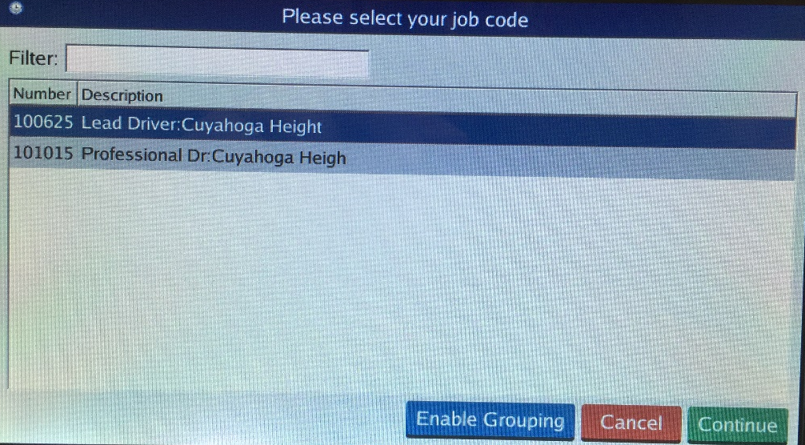
Select Job Code
During the clock-in process, if your account is associated to multiple job codes,
you’ll need to select a job code.
Notes:
Select the title you want to clock in for. Select continue.

Slide 29
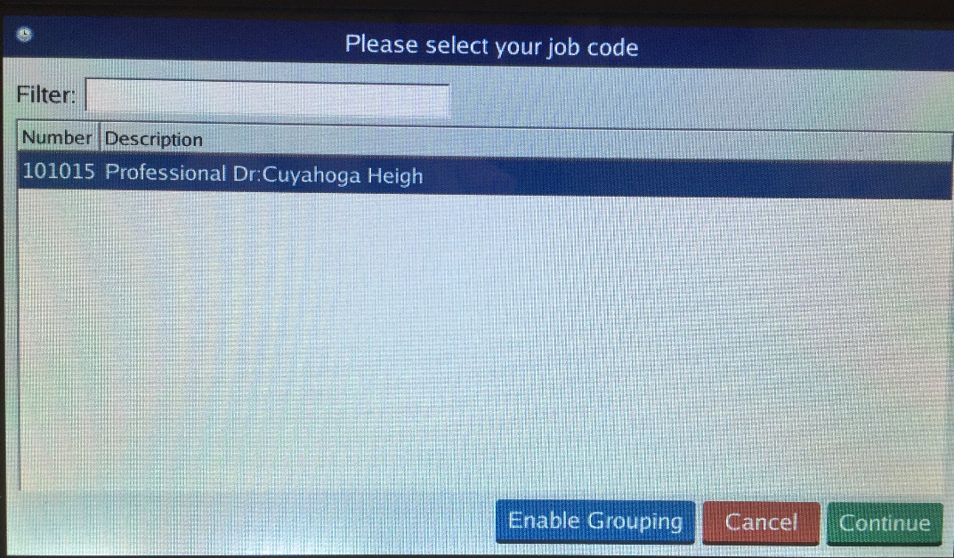
Change Job Code
To change job code during the day, follow the clock-in process and select a different job code.

Slide 30
Just for Fun…
You notice you made a mistake on your time and you have already submitted it for approval.
What should you do?
Contact Payroll—they can fix it for you.
Go into Workday and fix it yourself.
Contact your Timekeeper or Manager and ask them to send it back to you for your correction.
Notes:
If you have submitted it, you must contact your timekeeper and ask them to send it back or revise it for you.

Slide 31
Questions?
What went well?
What was difficult?
What questions do you have?

Slide 32
Time Off
Learning Objectives:
At the end of this module you will be able to…
Request sick time using the appropriate system
Request vacation time and/or special privilege days
View Time Off Balances
Submit a Leave of Absence request
Notes:
[See Activity Instructions #4]

Slide 33
Demo Time Off Worklet for Exempt & Non Exempt Employees
Time Off Worklet > View
My Time Off (your time off requests from SmartFind Express)
Time Off Balances—view you balance as of a certain date
Available balances as of now
Time Off Worklet > Request
Request time off
Cancel Request
Correct approved time off requests
Notes:
Say:
All employees can enjoy viewing accurate Time Off balances from Workday at any time.
We also use the Time Off Worklet to request time off for Sick time, Special Privilege and vacation time if you are eligible.
Let‘s take a look at what we can see and do from this worklet.

Slide 34

CMSD Vacation Process (for 12 month employees)
For all employees eligible for vacation time…
Vacation time accrues each pay period. In the past, employees did not have access to their vacation time in the first year. Now employees can take vacation as it accrues.
Vacation time is accrued in hours and may be taken in hours.
Vacation time will roll over from year to year There is no cap—there’s no “Use it or Lose it”*
*Exception: Vacation days will be paid out
upon separation up to a maximum of three years.
Notes:
Can enter/request vacation cash out through Workday, if eligible.
Vacation Cashouts:
Eligible employees: Central Office Non-Union employees and Custodians, Principals and Aspiring Principals
Can request it through time off in whole day increments

Slide 35
Just for Fun…
Which worklet allows you to request Time Off?
Where can you find your leave balance?
In what increments of time can you take sick and vacation time?
Notes:
Time or Time Off Worklet
Time Off Worklet
Any

Slide 36
Questions?
What went well?
What was difficult?
What questions do you have?

Slide 37
Mobile
Go Mobile!
Employees can use the mobile version of Workday for many functions. Use the Job Aid to download and get connected.
However, remember… Operations employees in areas with time clock units (Bus Depot, Central Kitchen) must use time clocks for time tracking if clocks are operational.
Note: Some functionality may not be available on the mobile app.
Notes:
SAY:
Employees can use the mobile version of Workday for many functions.
Remember… Operations employees in areas with time clock units (Bus Depot, Central Kitchen) must use time clocks for time tracking if the clocks are operational.
Use the Job Aid out on Getting Started to get connected with mobile!
Note: Some functionality may not be available on the mobile app.

Slide 38
Final Steps
Employee Self Service
Notes:
SAY:
Let’s begin to wrap up and review final steps.

Slide 39

Coming Attractions
July 1, 2017
Finance & Procurement
Talent/Performance
  for CRESS and
  Non-bargaining
  employees
Notes:
SAY:
Finance & Procurement is coming on or before July 2017.
Non-bargaining and CRESS employees will be using the Performance module for upcoming performance evaluation process.
CRESS: Classified Represented Educational Support Staff (ie: cleaners, food svc, transport, laborer)

Slide 40
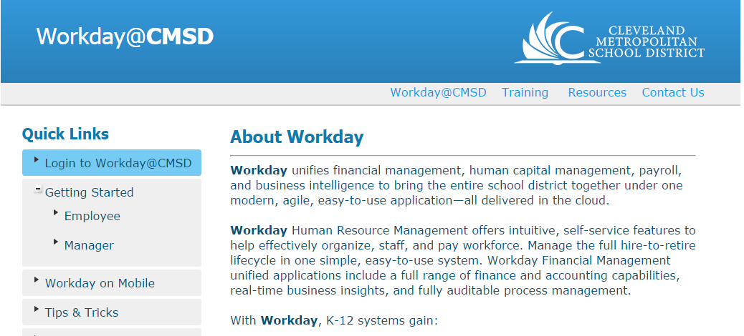
How to access Workday at Go Live!
When we go live, you will use your CMSD Network Password to log in.
Important: For shared computers, be sure to log out after using!
Notes:
SAY:
Today we were in the Training system. When we Go Live, you will access the Production System from this link on the Workday Website.

Slide 41
Go- Live Checklist
To-Dos at Go-Live:
Day One of Go-Live
Log in and enter your time worked
Update your personal info including emergency contact info
Validate your direct deposit or paycard information
Validate info on your position title and org structure
  Not correct? Use “Contact Us” to let us know!
Ongoing
Enter and submit your time worked for your manager approval
Notes:
Review slide…

Slide 42

Getting Help
Notes:
SAY:
What if you get stuck?

Slide 43
Where to go for help
For log in assistance
CMSD Service Desk
For questions on how to use Workday
The Getting Started pages on the Workday Website
  Videos, job aids and more!
Your manager or the Workday Point Person for your area
Workday Support Network Members
For corrections on organizational data in Workday, system breaks, & to make suggestions for improvement
The Workday Website > Contact Us
Notes:
Review slide…

Slide 44
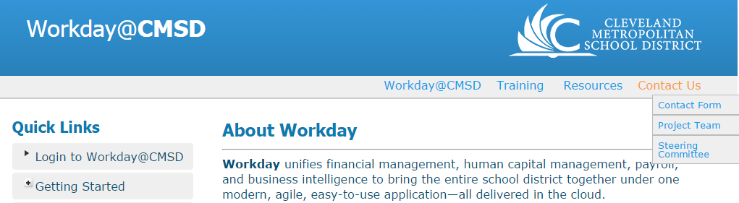
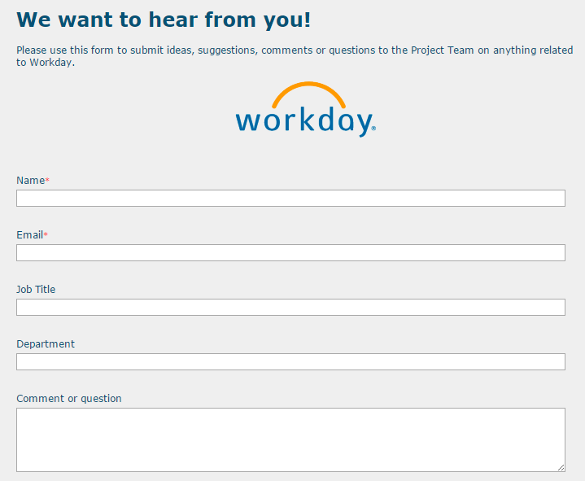
The Workday Change Request Process
Have a suggestion to improve Workday at CMSD?
Use our webpage to Contact Us…
Notes:
Review slide. This is what the Contact Us form looks like.

Slide 45

Graduation
Thanks for your participation. Your training is complete when you finish these items:
Online Class Evaluation—how did we do?
Training-Sign Off—your graduation step!
The Training Evaluation link is on the Training tab of Workday web page.
The Training Signoff is a hardcopy document—get this from your trainer.
Notes:
SAY:
Thank you for your participation! We look forward to continuing the journey as together we prepare for this new tool!
One final step before class is done…a sort of formal graduation step and to help us continue to improve. Please complete the class evaluation and Training-sign off.
The Evaluation can be found from the Workday Webpage>Training tab > Training Evaluation link.
The Training Sign-Off link is a simple acknowledgement statement.

